Slide 1
SRR & CVR Govt. Degree College (A) Vijayawada
DEPARTMENT OF MICROBIOLOGY
DNA Damage and Repair Mechanism
BY
Dr. K. Aruna
Lecturer in Microbiology
SRR & CVR Govt. Degree College (A) Vijayawada

Slide 2
DNA Damage and Repair Mechanism
Causes of DNA damage
1. Spontaneous mutations
2. Induced mutation
Enzyme based repair systems
Direct repair or Light Dependent or Photo reactivation
Excision repair a). Base excision repair b). Nucleotide excision repair
Methyl Directed mismatch repair
Post replication or recombination repair mechanism
SOS repair

Slide 3
DNA Damage and Repair Mechanism
Direct repair or Light Dependent or Photo reactivation
Direct repaid: DNA polymerase , 3- to -5 Exo nuclease proofreading activity Incorrect nucleotide id detected and removed
Repair of UV-induced pyrimidine Dimers :
Exposed to UV light in the wavelength of 320 to 370 nm
Photolyase – split the dimers
Repair of Alkylation damage: Methylguanine methyltransferase
:

Slide 4
DNA Damage and Repair Mechanism
2. Excision repair
a). Base excision repair :
Glycosyase enzyme
It recognize and cleave the bond between base and deoxy ribose sugar
Other enzymes cleave bond between sugar and phosphate , releasing the sugar and leaving a gap in DNA strand, gap is filled by DNA polymearse and and DNA ligase
b). Nucleotide excision repair (NER) or dark repair or excision repair
removes thymine dimers and DNA distortions
It involves four proteins, Uvr A, UvrB, UvrC and UvrD (Helicase)
DNA polymerase I : fill the gap
DNA ligase seals the final gap

Slide 5
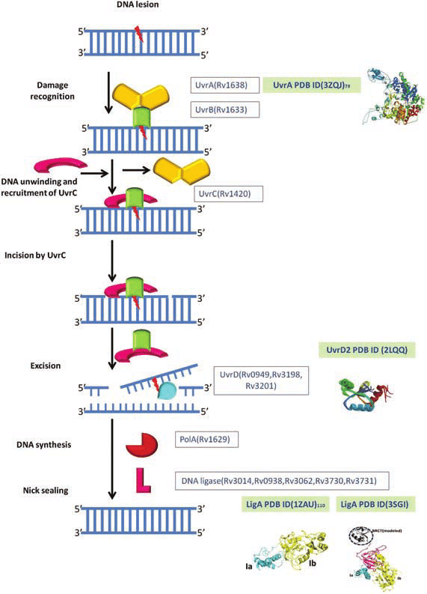
DNA Damage and Repair Mechanism

Slide 6
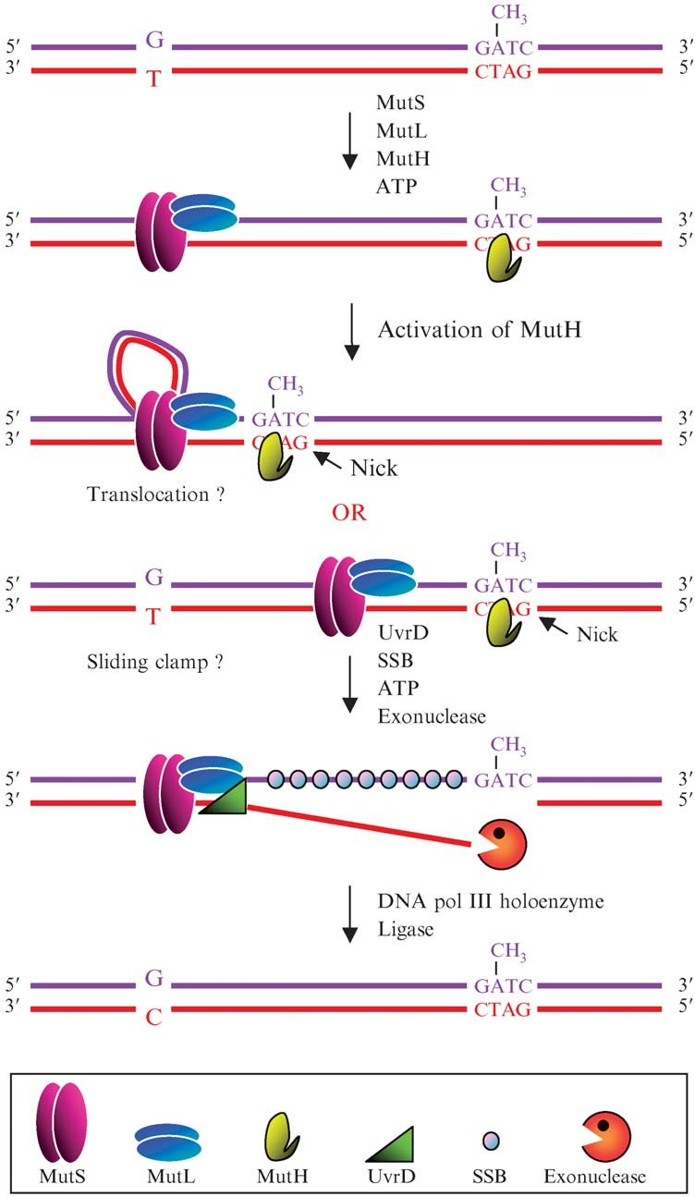
3. Methyl Directed mismatch repair

Slide 7
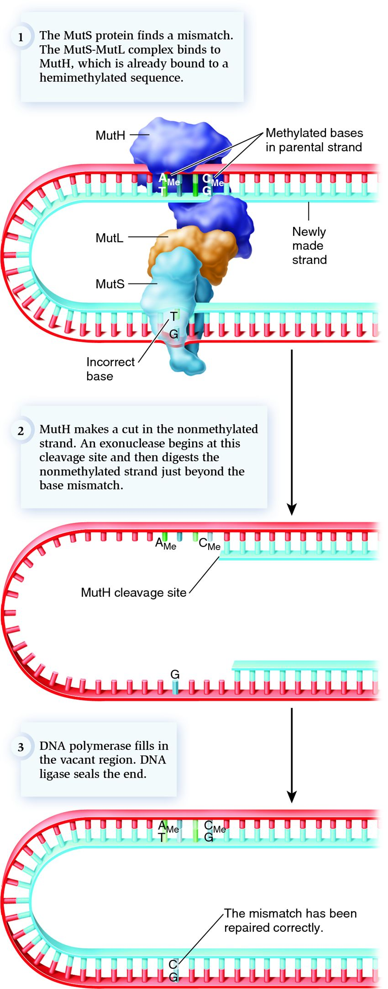
3. Methyl Directed mismatch repair

Slide 8
DNA Damage and Repair Mechanism
4. Post replication or recombination repair mechanism
Rec A protein initiate the recombination between two sister strands

Slide 9
DNA Damage and Repair Mechanism
5. SOS repair: last – resort , emergency response
SOS repair or “bypass” or “Emergency” repair is one of the DNA repair mechanisms introduced in 1975 by a scientist named Miroslav Radman. SOS repair primarily recovers the DNA damage caused due to environmental stresses. It serves as a regulatory system, which comprises many complex inducer proteins that repair the damaged DNA.
SOS system also includes a repressor protein, namely LexA. The RecA protein floats around the cell, which regulates the activity of LexA protein. The RecA regulatory protein mediates the repression or expression of LexA repressor.
Lex A – it repress the transcription of 17 genes , involve in repair
In the presence of damage
Rec A: which activates and stimulates the lex A

Slide 10
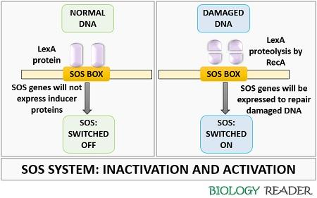

Slide 11


